Slide 1
Introduction to MySQL
Presented By : Pratiksha Sapkale

Slide 2
What is MySQL?
MySQL is a popular, open-source Relational Database Management System (RDBMS).
It is used to store, manage, and retrieve data in a structured format.
MySQL was developed by the Swedish company MySQL AB, which was founded by David Axmark, Allan Larsson, and Michael "Monty" Widenius.
Michael Widenius Known as the "Father of MySQL", Widenius played a key role in the development of the database management system.
He was responsible for the core features and architecture of MySQL, ensuring it was efficient, scalable, and compatible with various platforms.
MySQL uses SQL (Structured Query Language) to interact with the database.

Slide 3
Features of MySQL :
Open Source: Free to use with a strong community.
Cross-Platform: Runs on Windows, Linux, and macOS.
High Performance: Efficient in handling large databases.
Scalability: Suitable for small and large applications.
Security: Supports user authentication and data encryption.
Support for Transactions: Ensures data integrity with ACID compliance.

Slide 4
What is SQL ?
SQL stands for a Structured Query Language, it is a standard language for Relational Database Management System(RDBMS).
It is a programming language used for managing and manipulating RDBMS.
SQL code is used to send requests to a database.
The requests are known as queries.
RDBMS :
RDBMS is software used to store, manage, and retrieve data in a relational database.
A relational database organizes data into tables (rows and columns) that are connected to each other through relationships.

Slide 5
Data Types in MySQL :
String: CHAR, VARCHAR, TEXT, etc.
Numeric: INT, FLOAT, DECIMAL, etc.
String: CHAR, VARCHAR, TEXT, etc.
Date/Time: DATE, TIME, DATETIME, TIMESTAMP.
CHAR, VARCHAR, DATE, and TIME values should enclosed with single or(‘ ‘)
Double(“ ”)quotes in MySQL.

Slide 6
SQL Commands in MySQL :
Data Definition Language (DDL): Used to define the database structure.
CREATE, ALTER, DROP, TRUNCATE .
Data Manipulation Language (DML): Used to manipulate data.
SELECT, INSERT, UPDATE, DELETE.
Data Control Language (DCL): Used for permissions.
GRANT, REVOKE .
Transaction Control (TCL): Manages transactions.
COMMIT, ROLLBACK, SAVEPOINT.

Slide 7
Advantages of MySQL :
Cost-Effective: Free to use under the open-source license.
Integration Friendly: Works seamlessly with web technologies like PHP, Python, and Java.
Reliability: Known for its stability and reliability in handling large-scale applications.
High Availability: Supports replication for better data availability and backups.

Slide 8
MySQL Use Cases :
Web Development: Back-end for websites (e.g., WordPress, e-commerce sites).
Data Warehousing: Storing and analyzing large datasets.
Gaming: Real-time data storage for online games.
Enterprise Applications: Used in ERP, CRM systems.

Slide 9
Commonly Used MySQL Queries (Examples) :
Creating a Table :
CREATE TABLE students (
id INT AUTO_INCREMENT PRIMARY KEY,
name VARCHAR(50),
age INT,
grade CHAR(2)
);
Inserting Data:
INSERT INTO students (name, age, grade) VALUES ('Alice', 20, 'A');

Slide 10
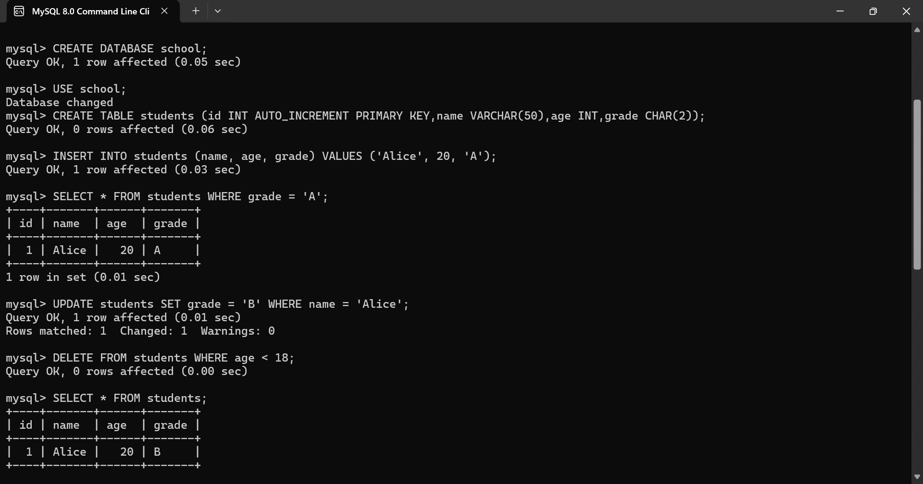
Retrieving Data:
SELECT * FROM students WHERE grade = 'A’;
Updating Dating:
UPDATE students SET grade = 'B' WHERE name = 'Alice’;
Deleting Data:
DELETE FROM students WHERE age < 18;

Slide 11
MySQL Use Cases :
Web Development: Back-end for websites (e.g., WordPress, e-commerce sites).
Data Warehousing: Storing and analyzing large datasets.
Gaming: Real-time data storage for online games.
Enterprise Applications: Used in ERP, CRM systems.

Slide 12
Real-World Applications of MySQL :
Used by companies like Facebook, Twitter, YouTube, and Airbnb.
Acts as the backbone for many websites and mobile applications.

Slide 13
THANK YOU !

